Slide 1
Humidification
Group 4
Rishabh P., Khoa N., Alexis G., Kyle H.
Chemical Engineering Lab I
09/15/25

Slide 2
Introduction
To study the transport of both mass & heat in a wetted wall column in order to obtain experimental values for the heat & mass transfer coefficients.
Performance parameters
Factors such as: gas flow rate, water temperature, column height, etc. Affect the efficiency of the column.
Heat & Mass Transfer
Humidification in a column is based off of the movement of water molecules from the liquid to gas phase.
Thermodynamics
Governs the maximum extent of humidification possible under certain conditions

Slide 3
Theory
Principles & Equations
Both heat and mass transfer control humidification. Heat is needed for water
𝑞 = ℎ ∙ Δ𝑇 (1)
𝑁𝐴 = 𝑘𝐶 ∙ Δ𝑐𝐴
𝑆ℎ = 𝑘𝐶 ∙ 𝐿/𝐷𝐴𝐵
𝑆ℎ = 0.023 ∙ 𝑅𝑒0.83 ∙ 𝑆𝑐0.44
GS′​dY′=kY​(Yi′​−Y′)Pdz
GS′​CS′​dT=h(Ti​−T)Pdz
Assumptions/Limitations
Dilute system – Water vapour in air assumed to be at low conc.
Thin film assumption – Water forms a uniform film
Negligible Heat Loss – Column is treated as adiabatic
Constant properties
Neglect coupling
Neglect bulk flow correction
Connection
Experimental setup – Wetted-wall column that has countercurrent air and water flow.
Measured data – Air inlet/outlet temp. and humidity, water temp. , air and water flows.
Goal – Determine kY (mass transfer coefficient), h (heat transfer coefficient), NTU, HTU
Validation – Compare experimental values to Sherwood number.

Slide 4
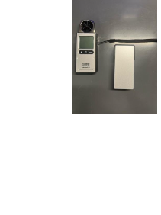
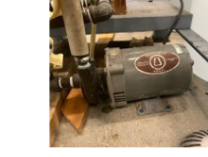
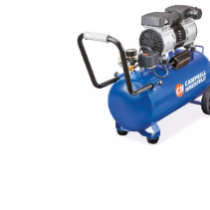
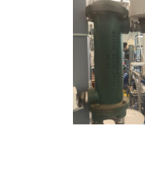
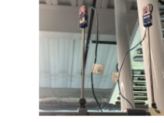
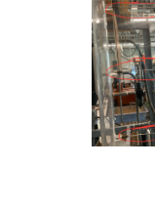
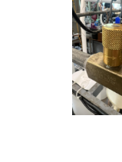
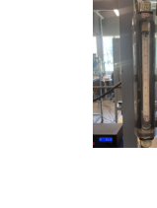
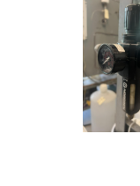
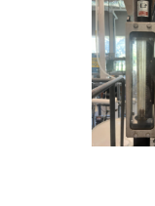
Apparatus
Anemometer (1)
Centrifugal Pump (2)
Compressor (3)
Heat Exchanger (4)
Regulator (5)
Rotameter (6)
Thermocouple (7)
Valve (8)
Wet-Bulb Thermometer (9)

Slide 5
Material & Supplies
Plexiglass wetted-wall column
Air supply
Rotameter
Centrifugal pump
Water holding tank
Weir
Heat exchanger
Thermocouples
Wet-bulb thermometer
Tubing & Fittings

Slide 6
Procedure
Pre-lab setup
Measure humidity & temp. of incoming air.
Ensure that the water tank is filled and pump is primed.
Verify apparatus is working.
Establish Water Film
Start pump and ensure adjust flow until entire wall is wetted.
Allow the system to achieve steady water temp. before introducing air.
Run Air Flow
Add air to the system at a chosen flowrate.
Allow the system to stabilize, then record the air/water temp., humidity and flow.
Collect Data
Repeat the process for different air flow rates, at different temperatures.

Slide 7
Experimental Challenges
Difficulties
Calculations need to be started early. (preferably first day so you can find out what is missing/needed)
Most of the needle valves are highly sensitive and adjustments have to be delicate.
Making sure the entire column gets wetted
Lessons Learned
Start temperature readings at a lower point. (getting temp. from high to low takes too long a time)
Getting a stable reading also takes a lot of time, if past 10 mins, take a reading in the next 2 mins.
*Caution – The airflow does not exceed 6-7
Column temperature also varies heavily as it is not fully insulated.
Look out for:
The anemometer does turn off after a period of inactivity.
Ensure when changing temperature, gloves are worn, even if you do not touch the heat exchanger (e.g. only the valve)
Check temp. gauge regularly as sensitive valves can cause irregular increase/decrease

Slide 8
Safety
Wear gloves/mitts at all times when dealing with the heat exchanger
Do not touch column when in use.
Take readings from the anemometer at a distance - although it is water and air, direct flow can be dangerous.

